Slide 1
One hidden layer
Neural Network
Neural Network
Representation

Slide 2


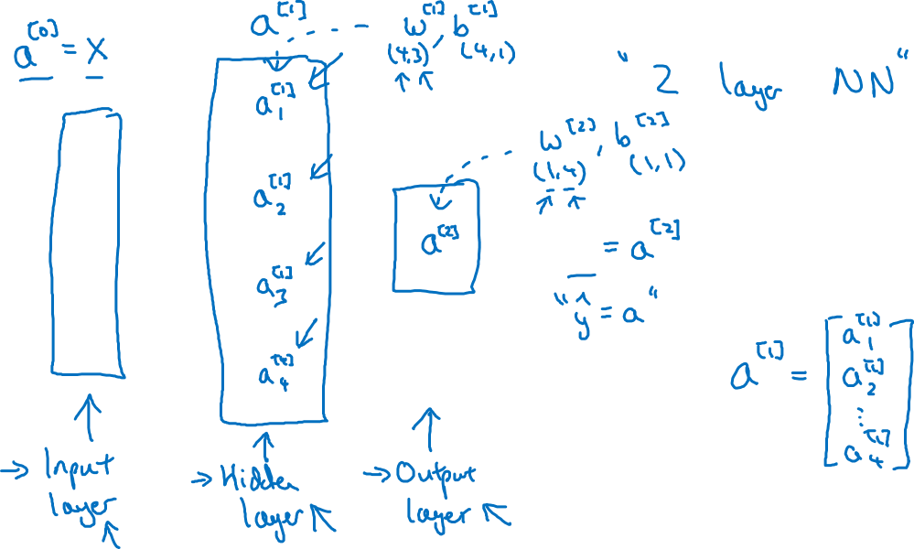


Neural Network Representation
$$x_{1}$$
$$x_{2}$$
$$\hat{y}$$
$$x_{3}$$

Slide 3
One hidden layer
Neural Network
Computing a
Neural Network’s
Output

Slide 4











Neural Network Representation
$$x_{1}$$
$$x_{1}$$
$$x_{2}$$
$$σ(z)$$
$$a=\hat{y}$$
$$x_{2}$$
$$\hat{y}$$
$$w^{T}x+b$$
$$z$$
$$a$$
$$x_{3}$$
$$x_{3}$$
$$z=w^{T}x+b$$
$$a=σ(z)$$

Slide 5

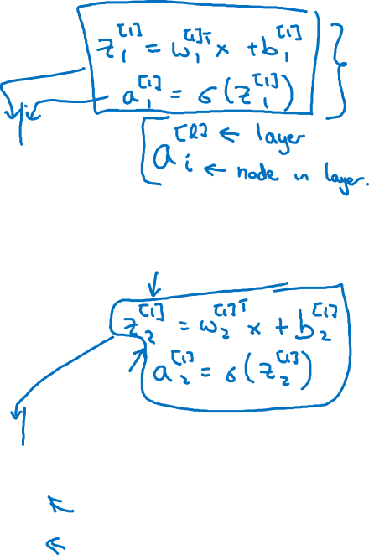





Neural Network Representation
$$x_{1}$$
$$x_{1}$$
$$x_{2}$$
$$σ(z)$$
$$a=\hat{y}$$
$$x_{2}$$
$$\hat{y}$$
$$w^{T}x+b$$
$$z$$
$$a$$
$$x_{3}$$
$$x_{3}$$
$$z=w^{T}x+b$$
$$x_{1}$$
$$a=σ(z)$$
$$x_{2}$$
$$\hat{y}$$
$$x_{3}$$

Slide 6

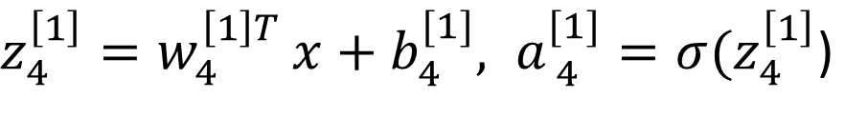


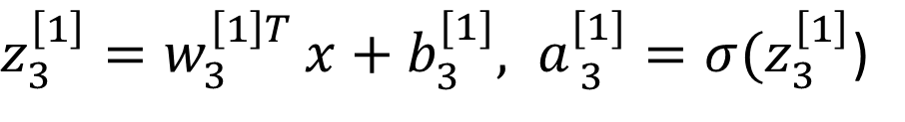


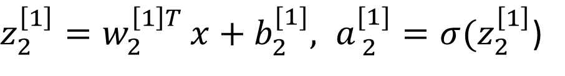

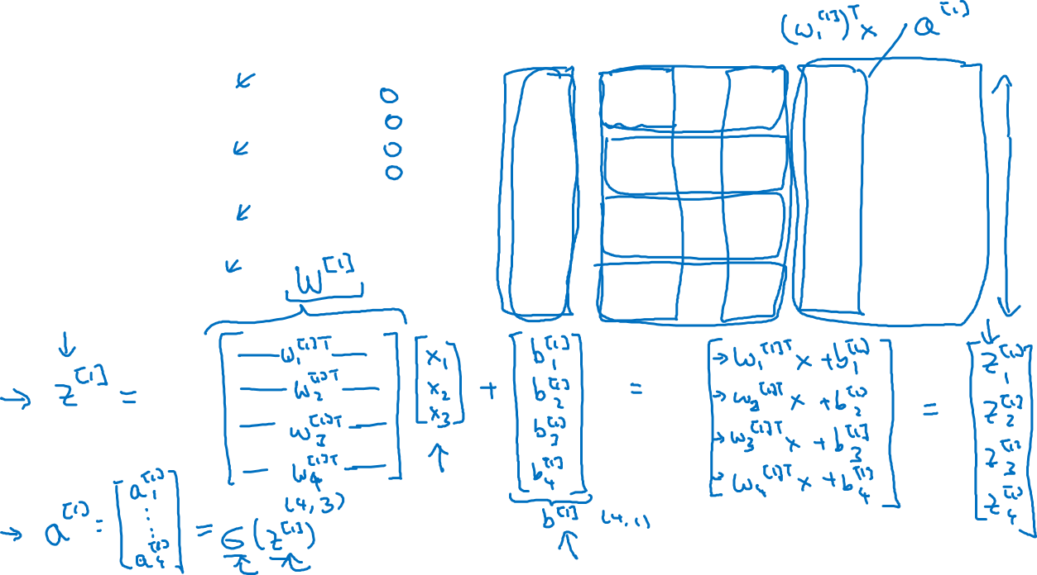
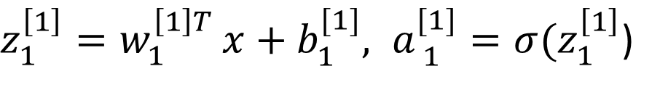


Neural Network Representation
$$a_{1}^{\left[1\right]}$$
$z_{1}^{\left[1\right]}=w_{1}^{{\left[1\right]T}^{ }}x+b_{1}^{[1]}, a_{ 1}^{[1]}=σ(z_{1}^{\left[1\right]}$)
$$x_{1}$$
$$a_{2}^{\left[1\right]}$$
$z_{2}^{\left[1\right]}=w_{2}^{{\left[1\right]T}^{ }}x+b_{2}^{[1]}, a_{ 2}^{[1]}=σ(z_{2}^{\left[1\right]}$)
$$x_{2}$$
$$\hat{y}$$
$$a_{3}^{\left[1\right]}$$
$z_{3}^{\left[1\right]}=w_{3}^{{\left[1\right]T}^{ }}x+b_{3}^{[1]}, a_{ 3}^{[1]}=σ(z_{3}^{\left[1\right]}$)
$$x_{3}$$
$$a_{4}^{\left[1\right]}$$
$z_{4}^{\left[1\right]}=w_{4}^{{\left[1\right]T}^{ }}x+b_{4}^{[1]}, a_{ 4}^{[1]}=σ(z_{4}^{\left[1\right]}$)

Slide 7



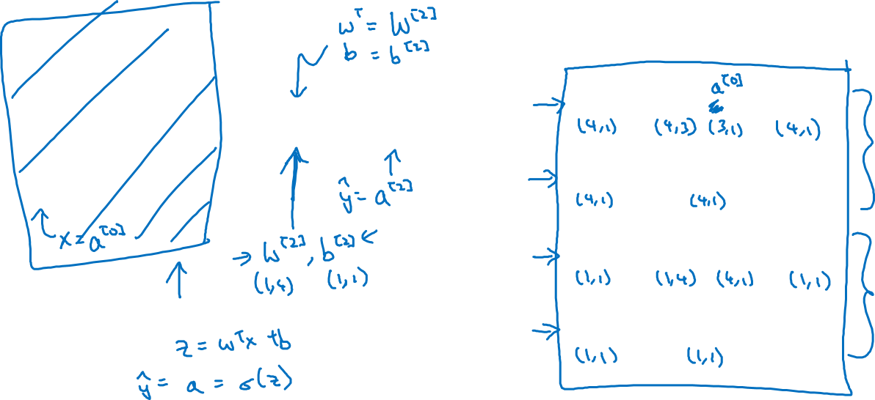

Neural Network Representation learning
$$a_{1}^{\left[1\right]}$$
Given input x:
$$x_{1}$$
$$a_{2}^{\left[1\right]}$$
$$z^{\left[1\right]}=W^{\left[1\right]}x+b^{\left[1\right]}$$
$$x_{2}$$
$$\hat{y}$$
$$a_{3}^{\left[1\right]}$$
$$x_{3}$$
$$a^{\left[1\right]}=σ(z^{\left[1\right]})$$
$$a_{4}^{\left[1\right]}$$
$$z^{\left[2\right]}=W^{\left[2\right]}a^{\left[1\right]}+b^{\left[2\right]}$$
$$a^{\left[2\right]}=σ(z^{\left[2\right]})$$

